Slide 1
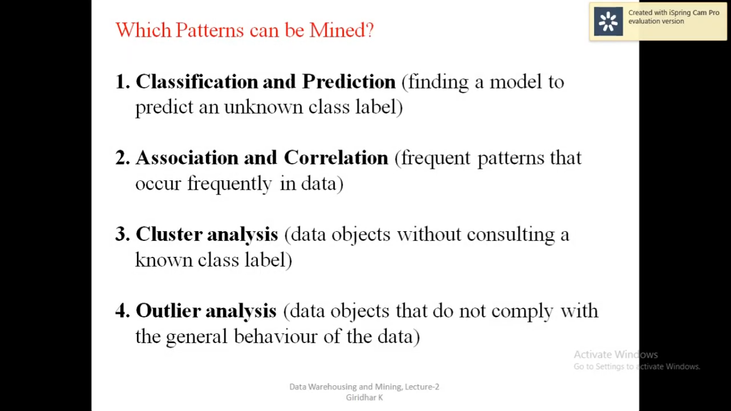
DATAMINING TECHNIQUES

Slide 2
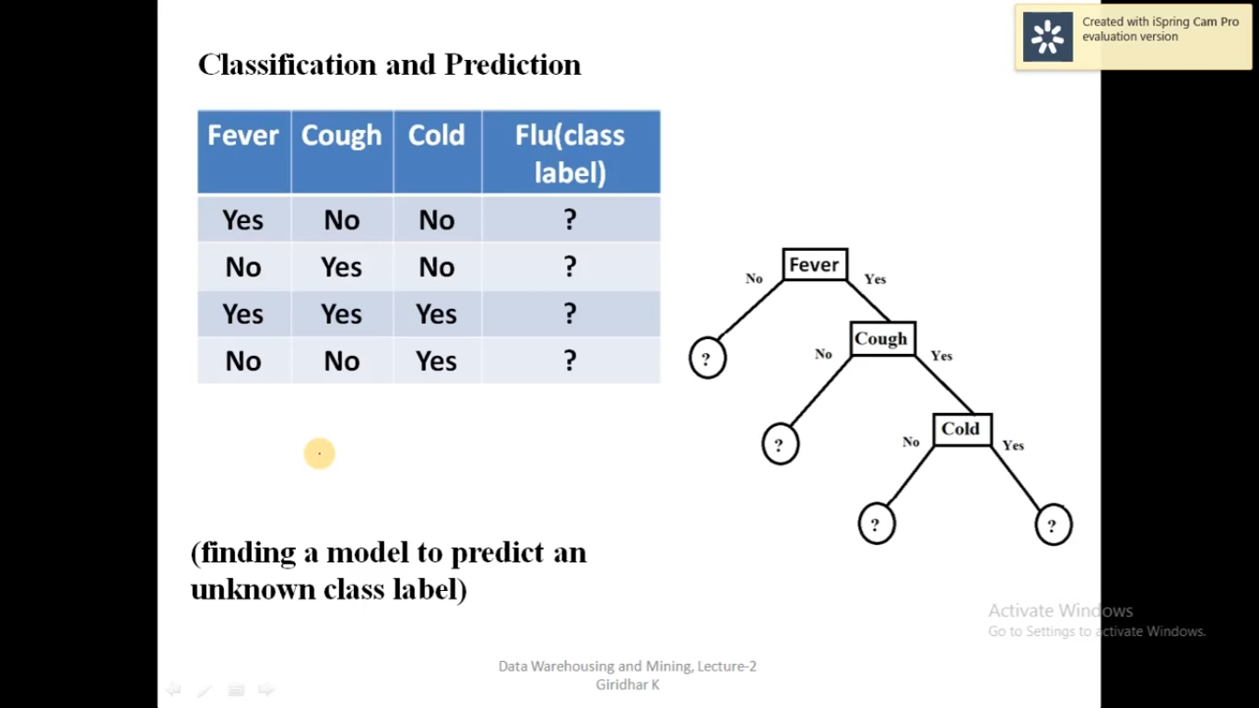

Slide 3
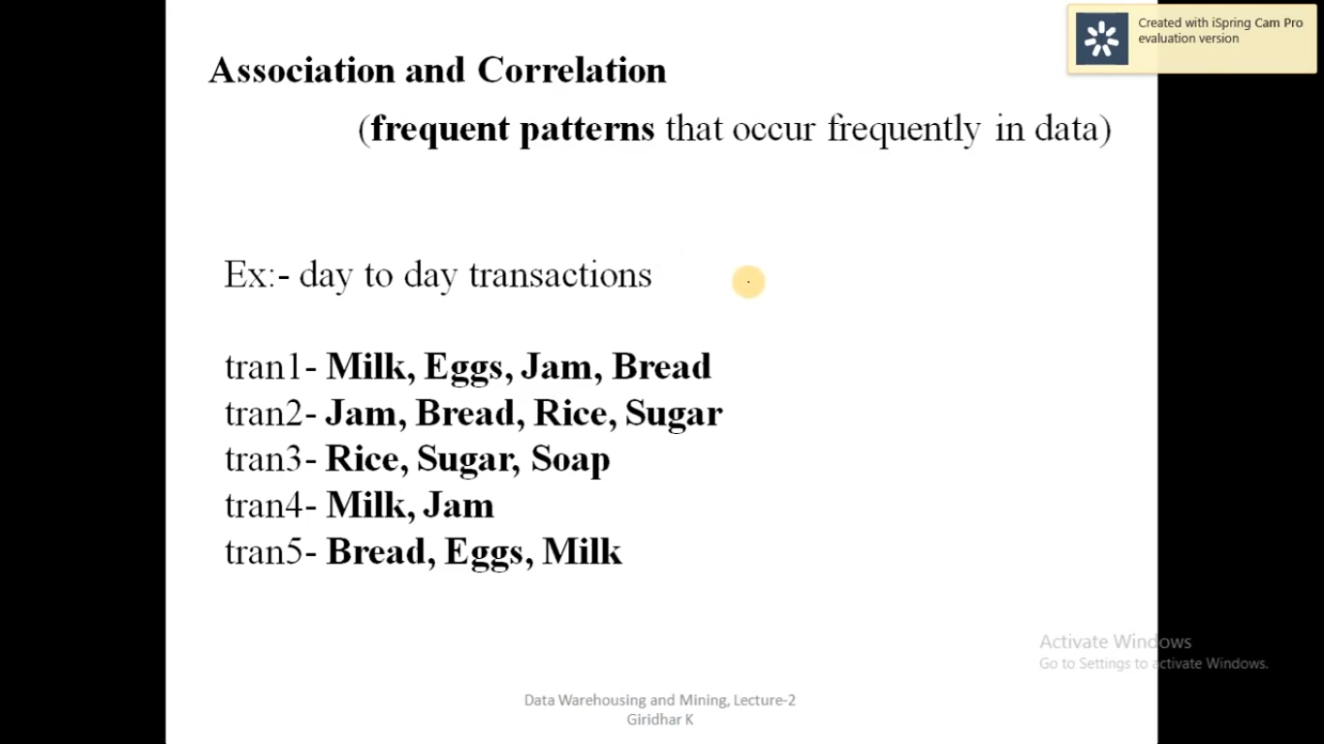

Slide 4
Regression:
Regression analysis is the data mining process is used to identify and analyze the relationship between variables because of the presence of the other factor.
Outer detection:
This type of data mining technique relates to the observation of data items in the data set, which do not match an expected pattern or expected behavior.
Sequential Patterns:
The sequential pattern is a data mining technique specialized for evaluating sequential data to discover sequential patterns.
Prediction:
Prediction used a combination of other data mining techniques such as trends, clustering, classification, etc. It analyzes past events or instances in the right sequence to predict a future event.

Slide 5
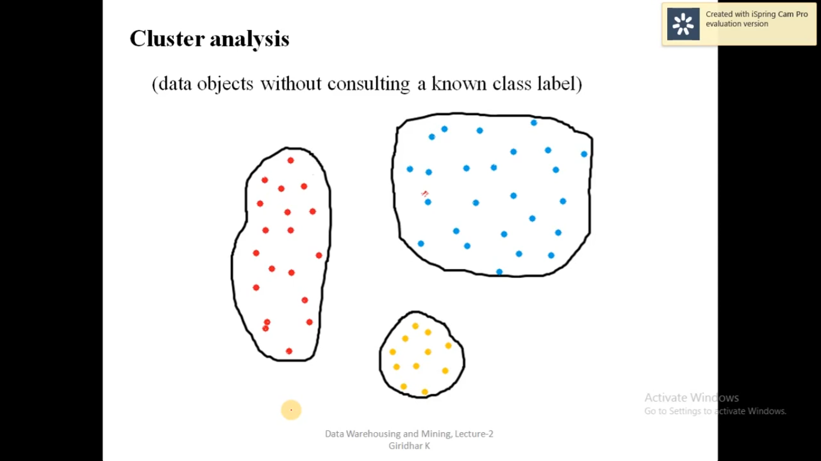

Slide 6
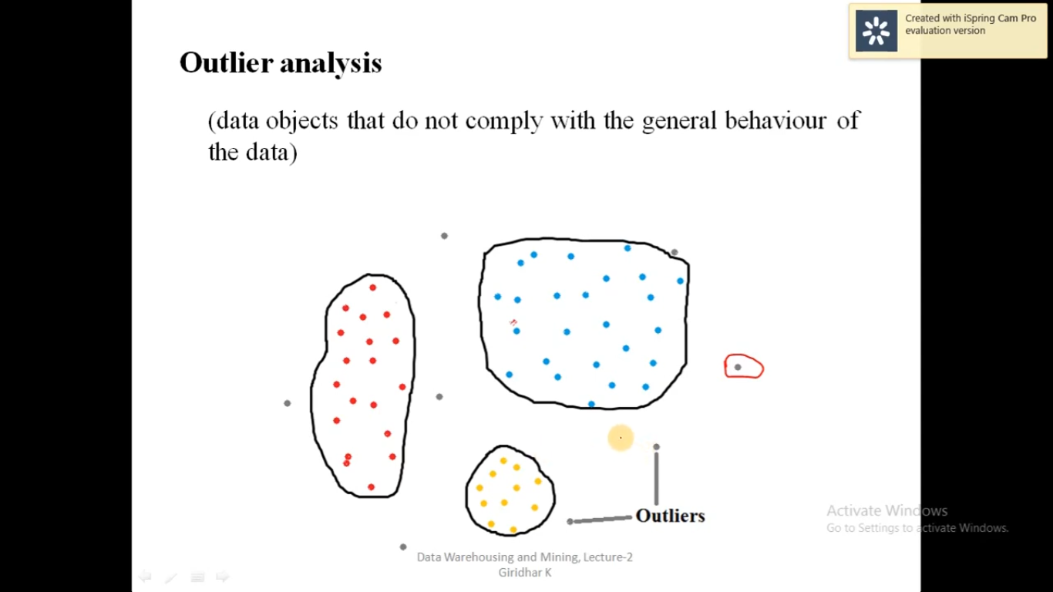

Slide 7
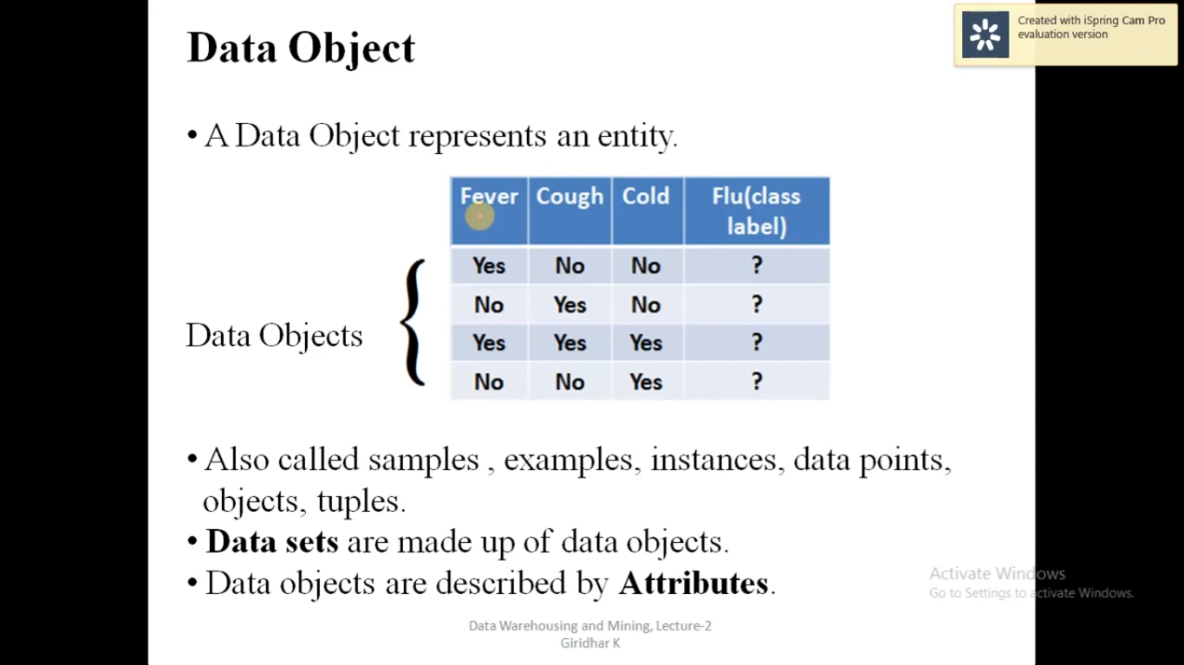

Slide 8
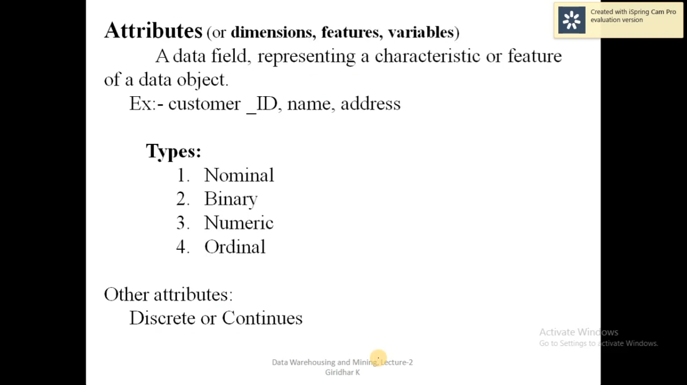

Slide 9
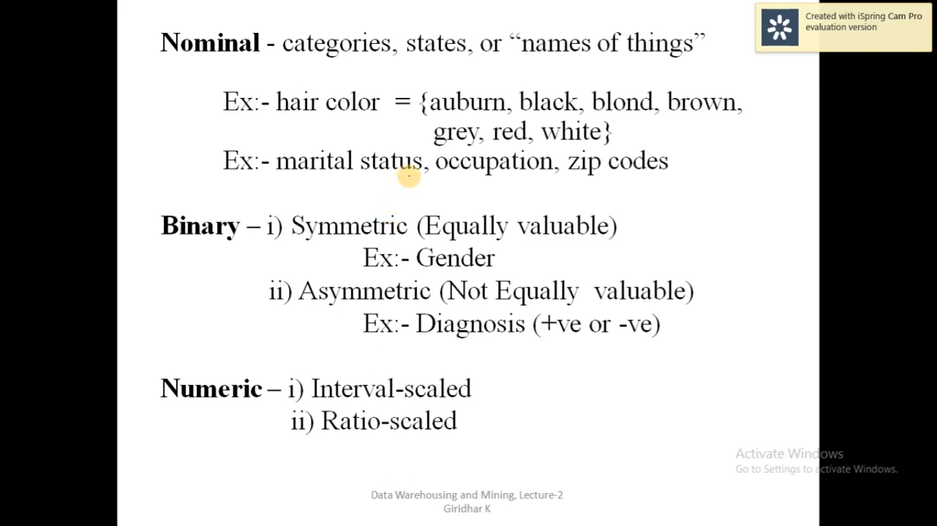

Slide 10
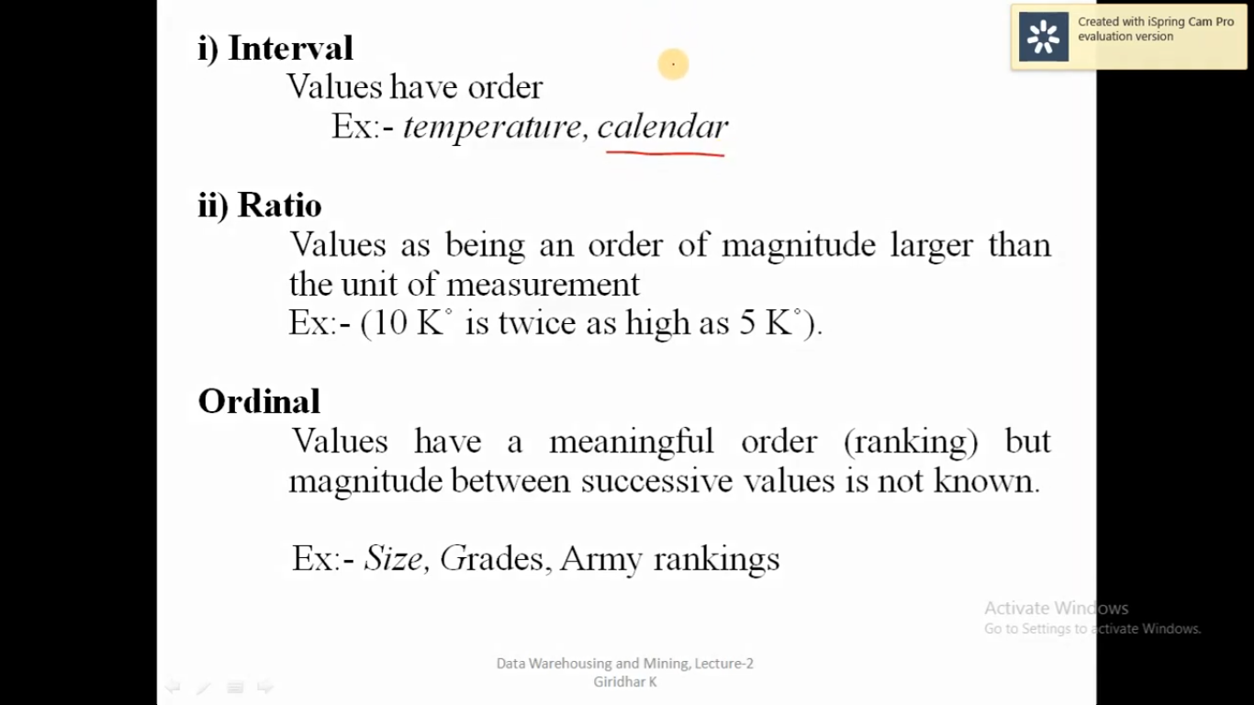

Slide 11
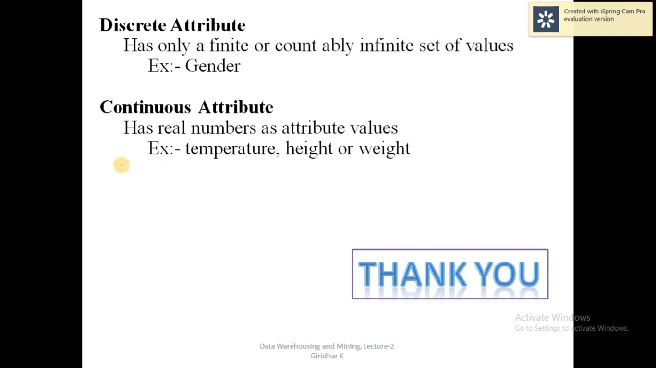

Slide 12
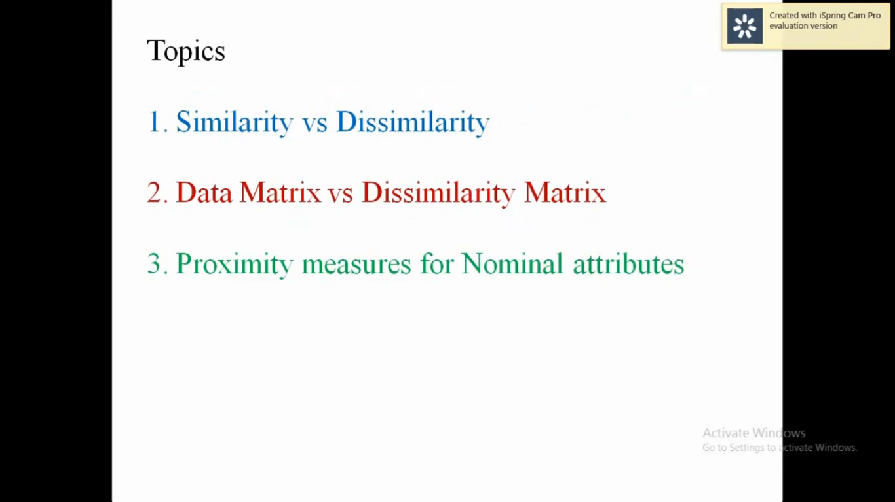

Slide 13
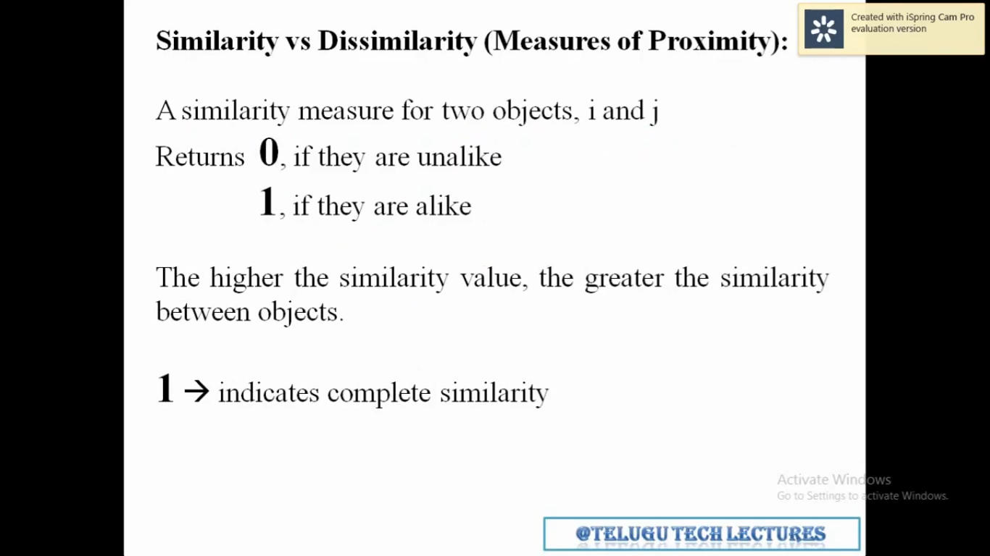

Slide 14
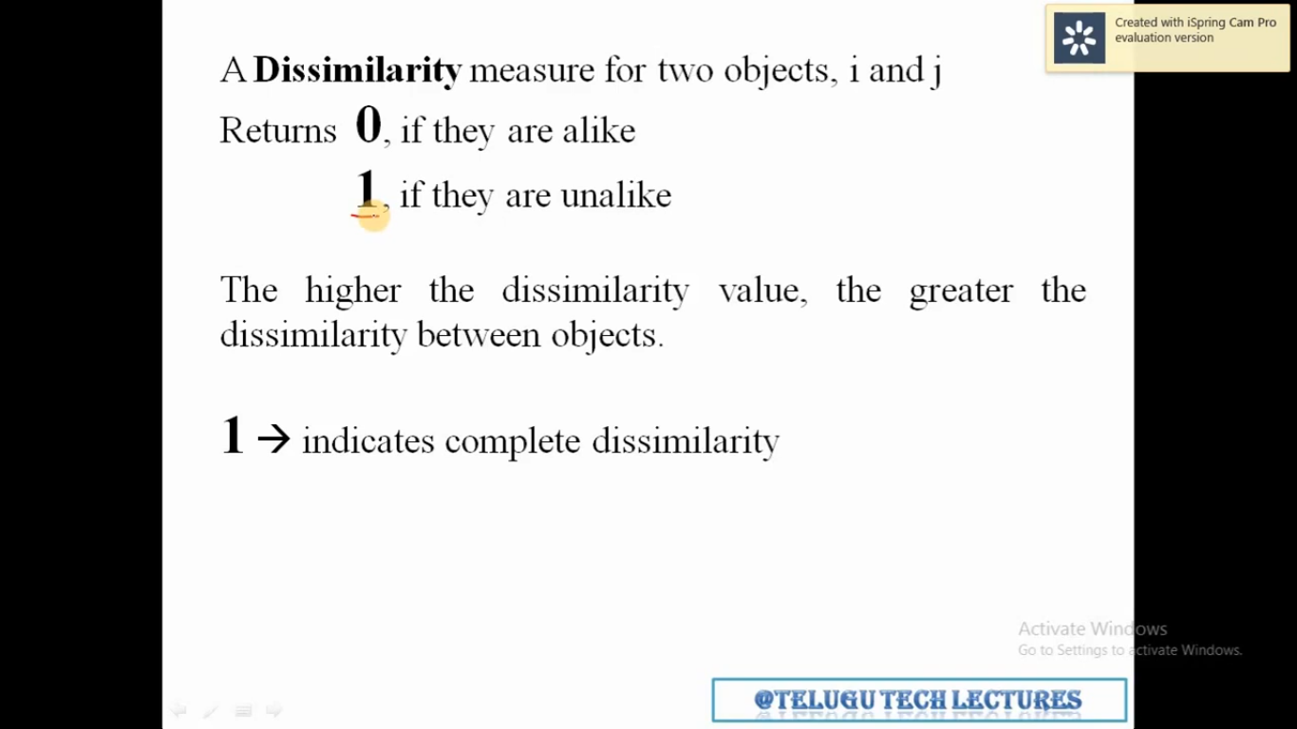

Slide 15
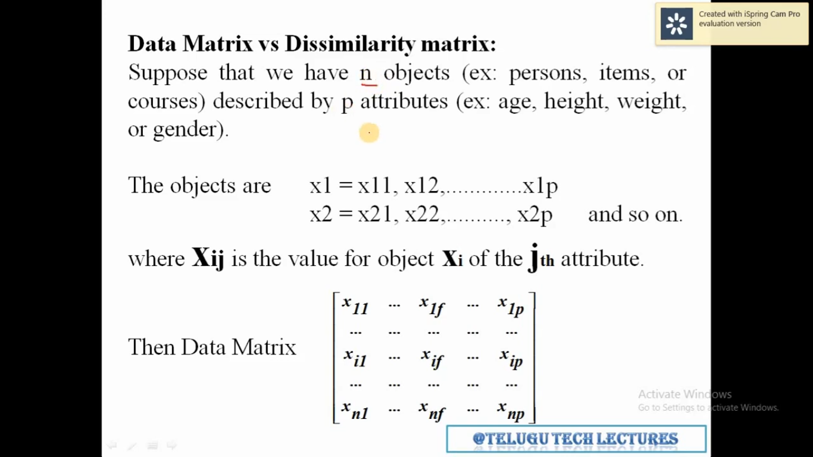

Slide 16
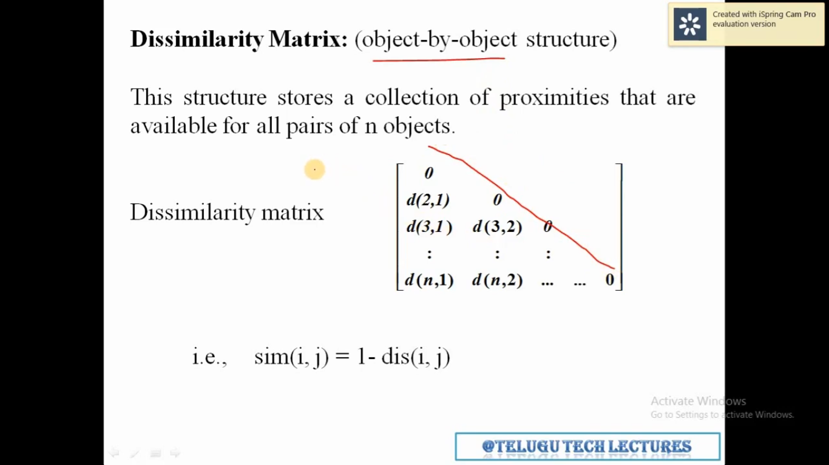

Slide 17
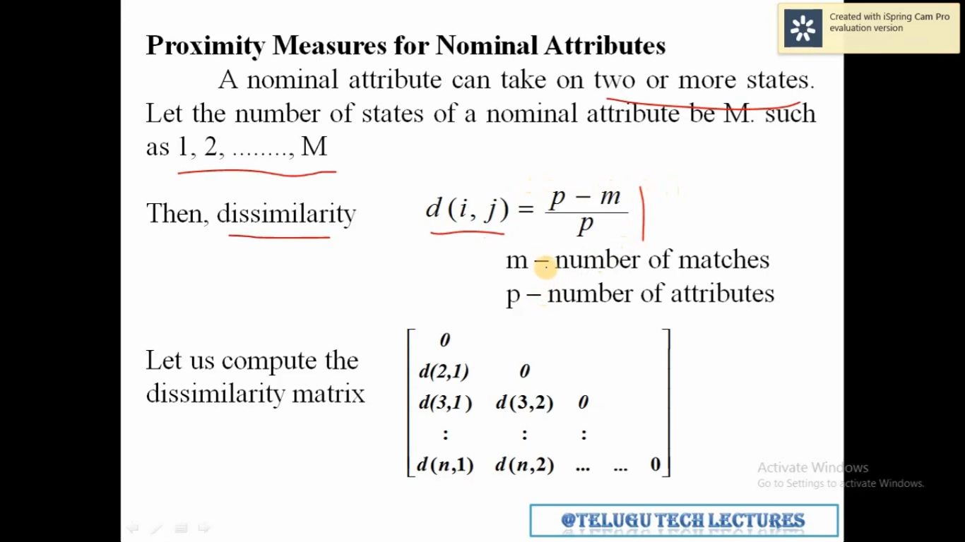

Slide 18
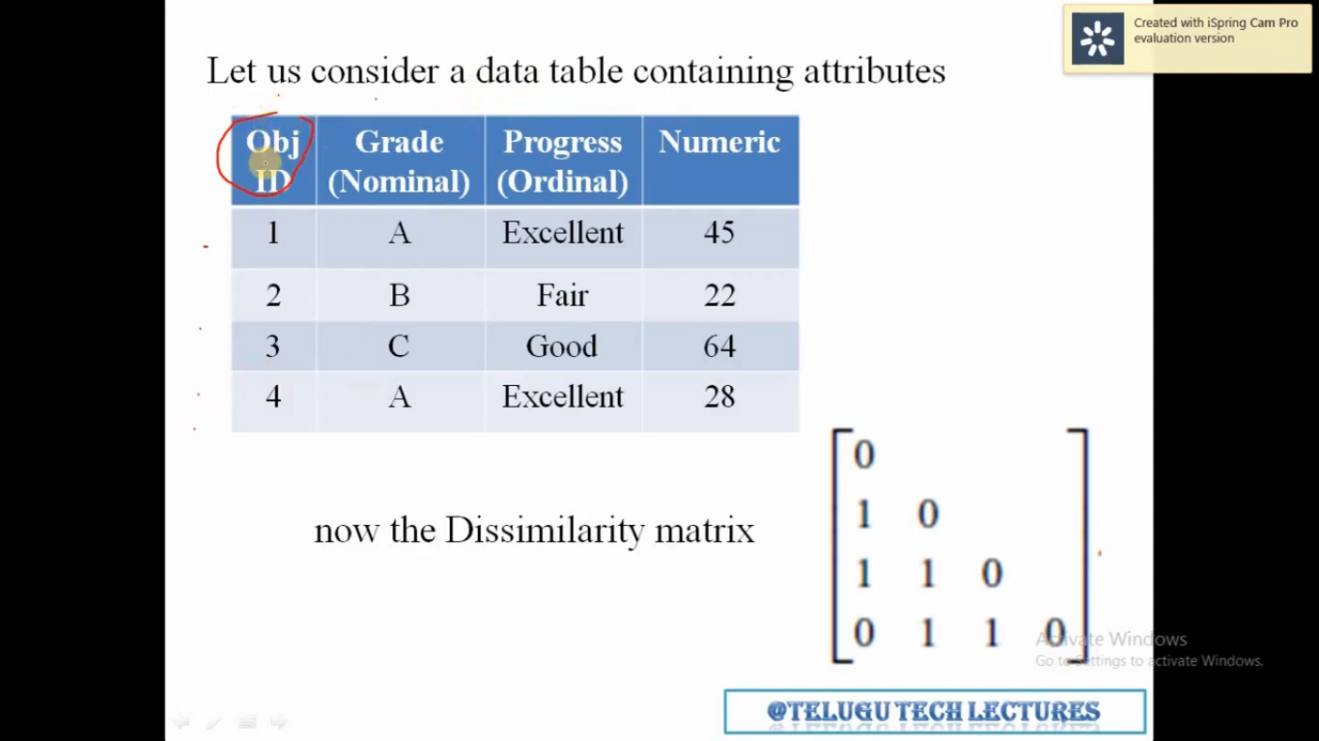

Slide 19
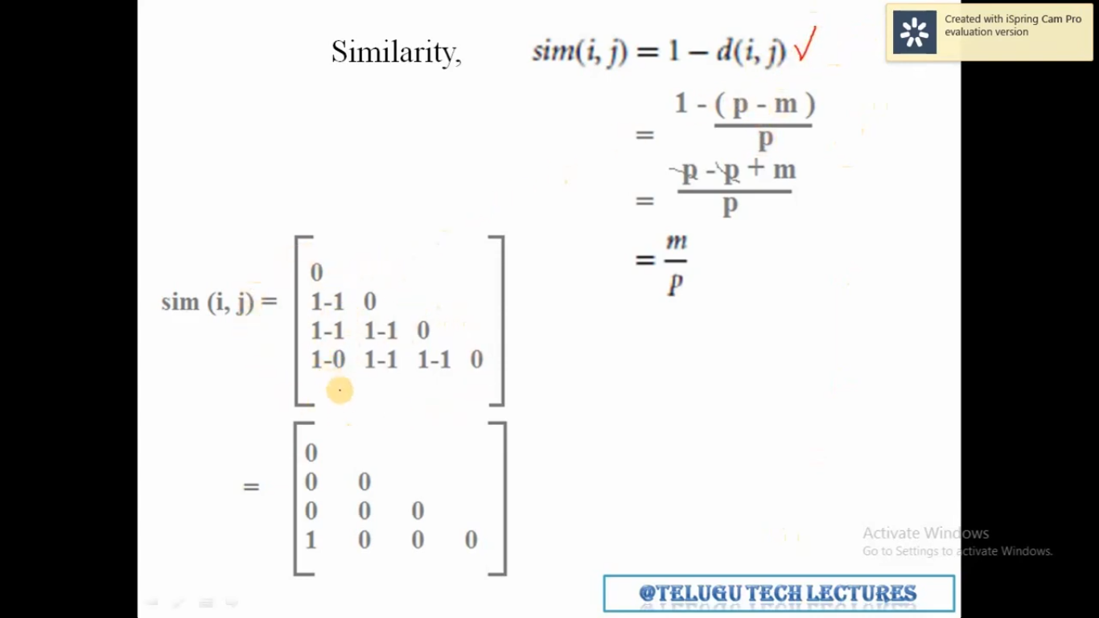

Slide 20
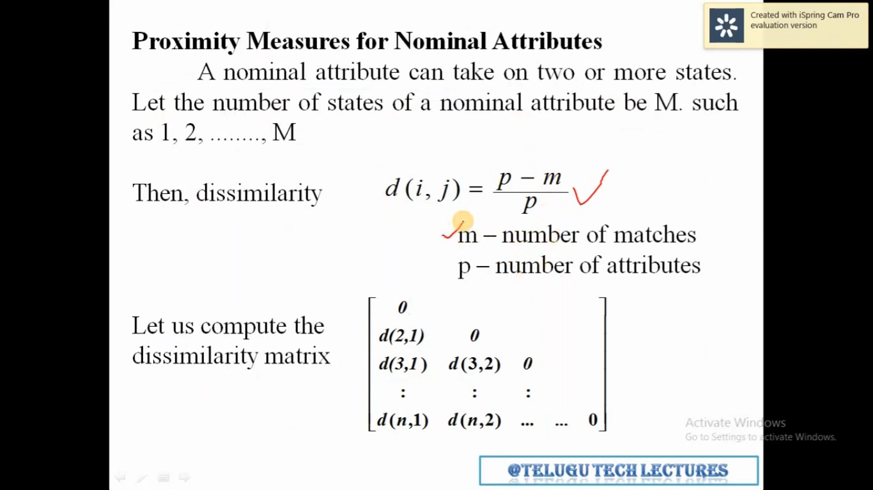

Slide 21
